Slide 1

Why food security and resilience should be a political priority
Tim Lang
Centre for Food Policy t.lang@city.ac.uk
For ‘Food Shocks: Is Wales ready for an unstable global food system?’
April 16th 2024, Pierhead Building, Cardiff Bay, Cardiff

Slide 2
Key Messages
Food security is more than supply
Food resilience is more than bounce-back to b-a-u
Food security + resilience require food system engagement
Shocks to the food system are here and likely to intensify
Politics of ‘leave it to Tesco et al’ is no longer appropriate
Public mood is uncertain; assumes ready access at affordable prices
Other countries engage public more
This is a political and food system opportunity
a post-WWll food era is coming to an end…. Now what?

Slide 3
What about Wales?
Wales agri-food politics are being dragged into SFS focus
But food is not just farming; it is a total system
Resistance to change is understandable but …
Wales has +ve structures e.g. Food Partnerships, 4 LRFs, a food renaissance but it’s fragile
We need new local Food Resilience Committees alongside LRFs
A ‘whole of society’ focus (not just commerce and farming)
New focus must centre on feeding people….
Ask: what is needed if and when shocks happen?
Who will feed the cities?

Slide 4
1. Risks to security and resilience are real
To food
To people
To infrastructure
To short/long term

Slide 5
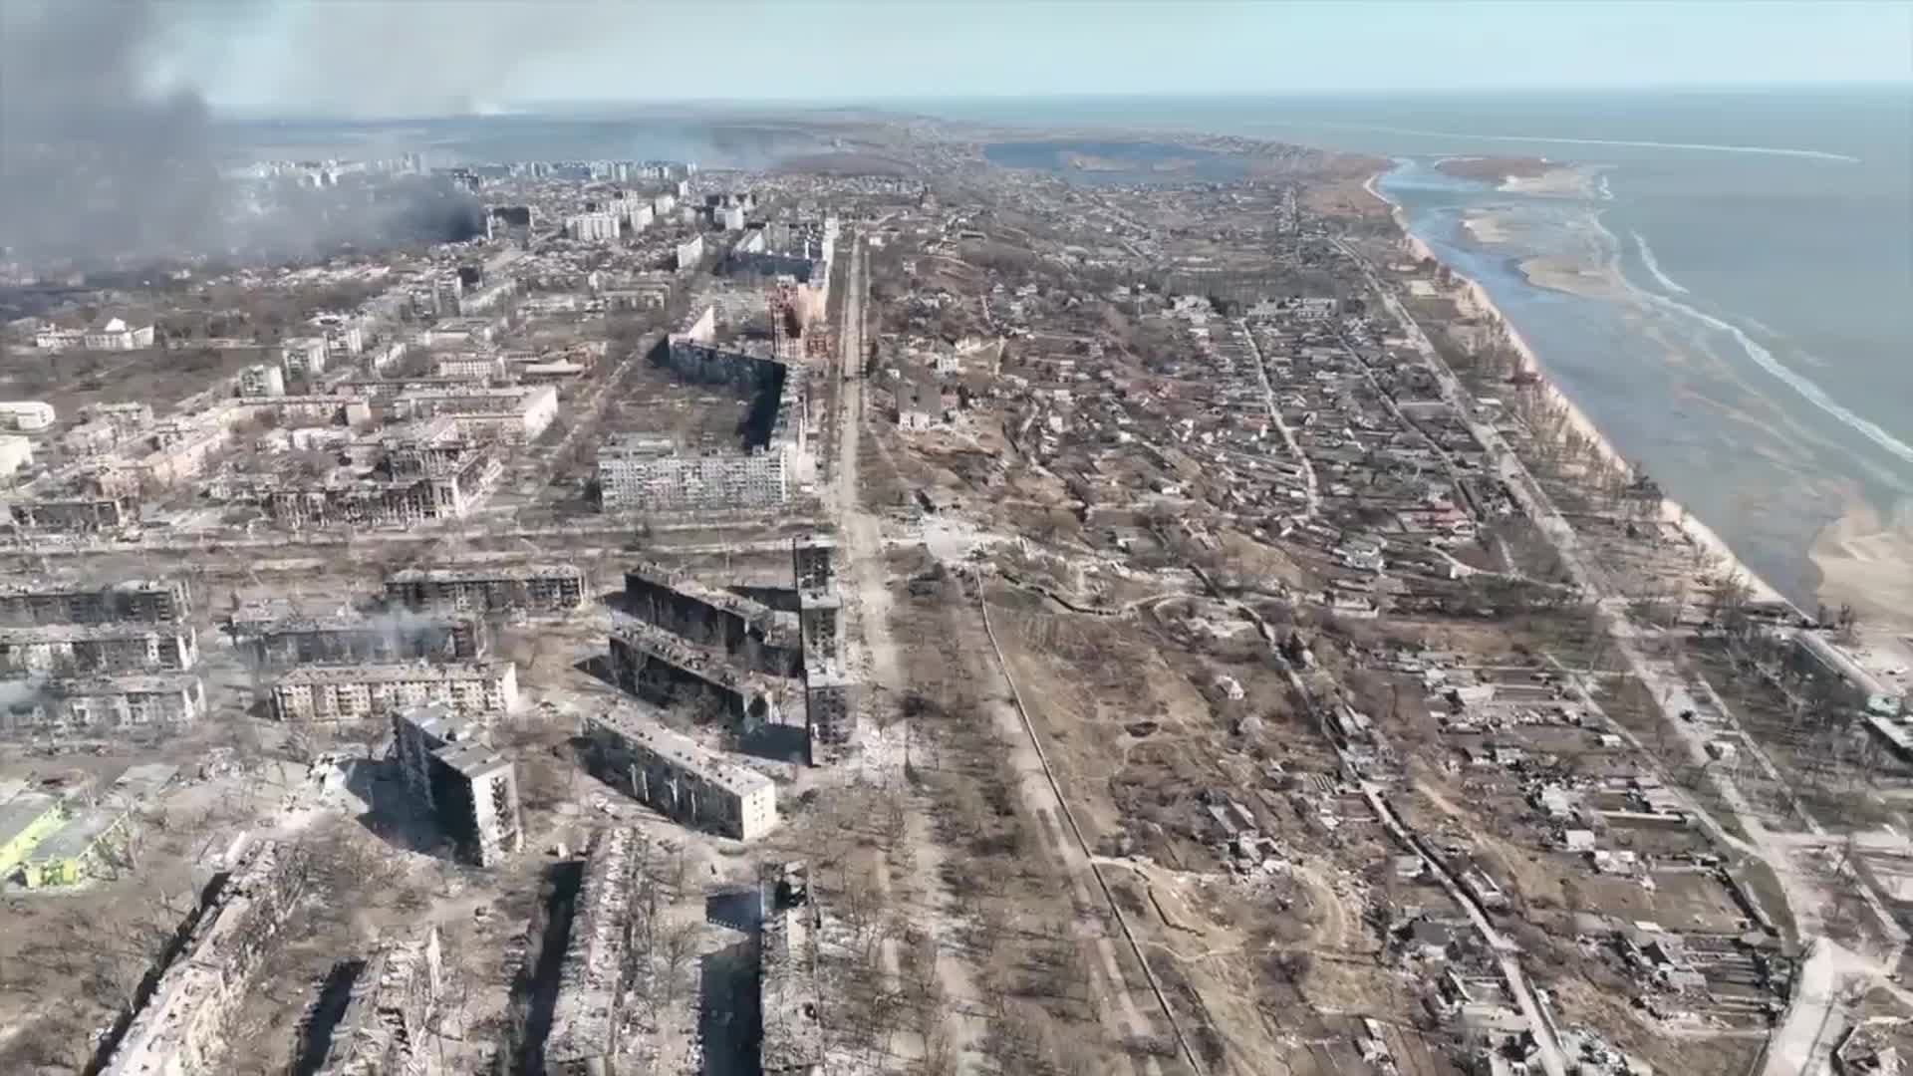
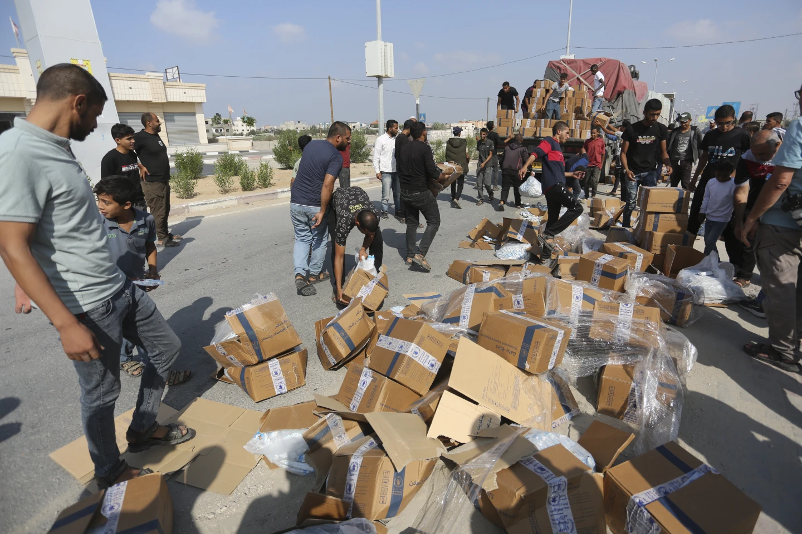
Some potential sources of food system shock
Environmental:
  Climate, ecosystems breakdown, water (drought/floods), fire
Resource shortage:
  Oil, phosphate, labour, capital
  Food ingredients or particular commodities
Aggression:
  Logistics disruption via software, satellite, shipping, road, rail, air
  Food is ‘weaponised’ by blockade, attack on RDCs
  in extremis, invasion, infrastructure destruction → war
Economic:
  Poverty / inequality, wage +price spiral
  Trade intervention or friction → JiT breakdown
  Ransomware, malware → a factory or multi-sectors
Societal:
  social divisions, poverty
  Stockpiling→ riot, looting
Political:
  Loss of trust …rumours …deliberate falsehoods (internet)
  Weak / incompetent government; weak local structures
Health:
  Pandemic → Workforce loss , insufficient labour etc
  Poor general health of public → unskilled, unentitled
Port of Mariupol, Ukraine after bombing, 2022
UN food lorry looted, Gaza, 2024

Slide 6
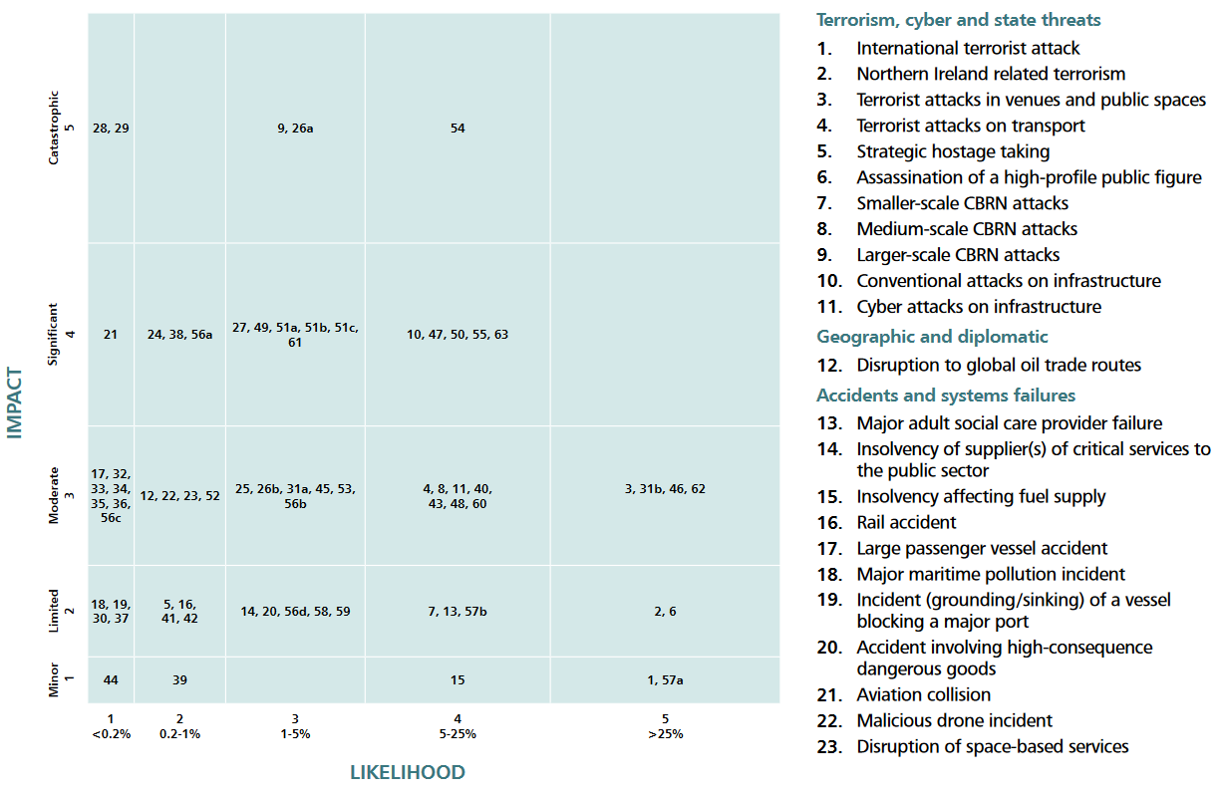
89 Risks to UK source:
NRR 2023
Chemo, bio, radio, nuke attack
pandemic
cyber attack on infrastructure
9 themes:
• Terrorism
• Cyber
• State threats
• Geographic &
diplomatic
• Accidents & systems failures
• Natural & enviro hazards
• Human, animal & plant health
• Societal
• Conflict & instability
Sunk vessel blocks port

Slide 7

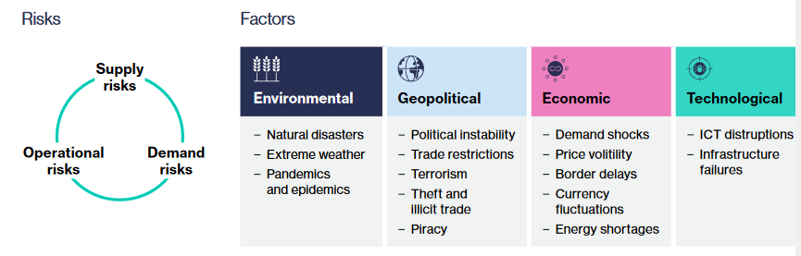
Food Risks (business view 1) source: Lloyd’s and Willis, Towers, Watson, 2022

Slide 8
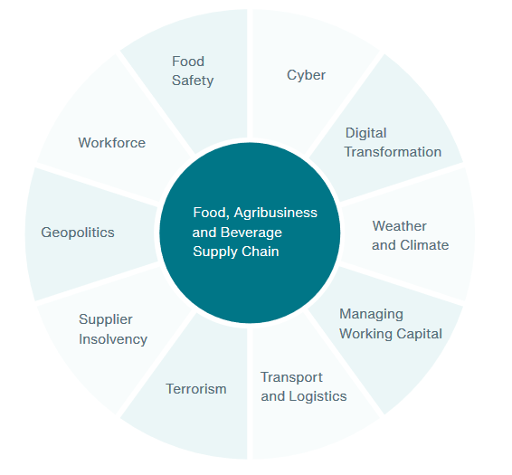
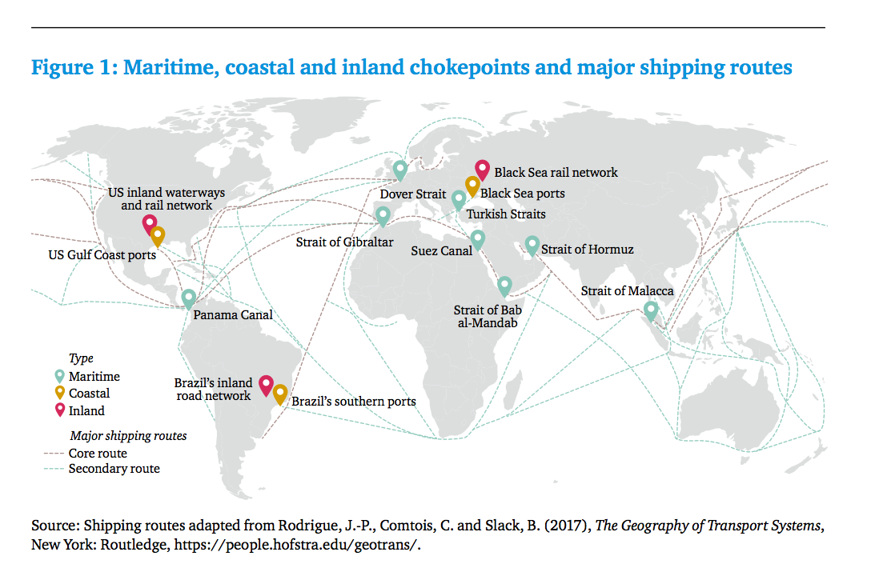
Food risks (business 2): spot the chokepoints
Source: Aon plc 2023
Source: WEF / Chatham House 2017

Slide 9

Food risks (business 3)
IGD 10 threats (21.iii.2024)
Climate change (will worsen + raise prices by 20% by 2050)
Water stress (pollution, extremes)
Agricultural challenges (subsidies ignore food)
Biodiversity loss (eg pollinators)
Disease (livestock + plant)
Geopolitics (food power use)
Labour (shortages)
Economics (stalling profits, low investment)
Opacity (low transparency)
Cybercrime (worsen + AI)

Slide 10
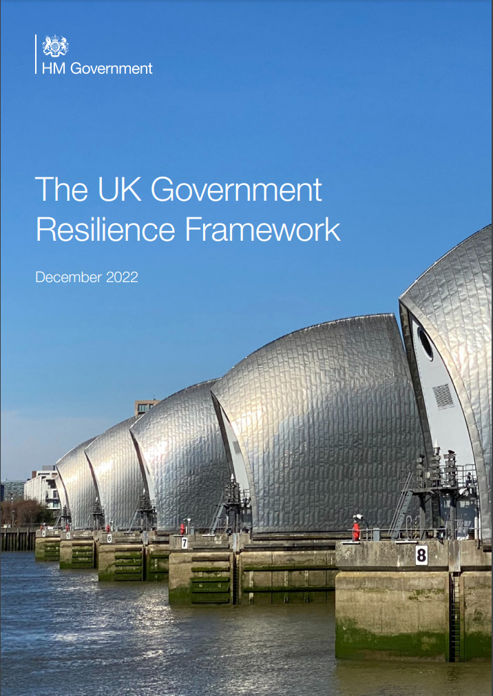
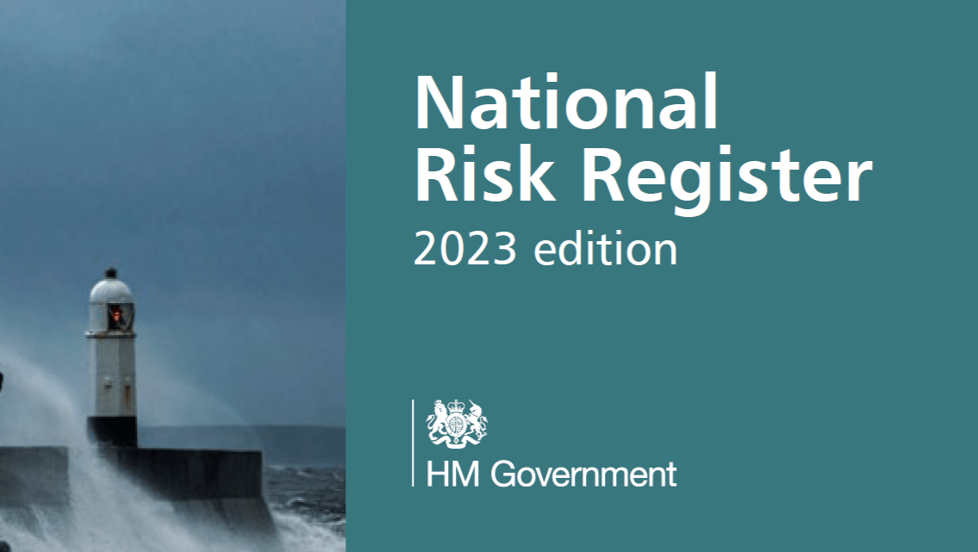

2. Institutional architecture: only partly addresses food
A long problem for the British state
Security & Resilience are in different ‘channels’

Slide 11
National food security – a default UK sore
1848 Repeal of Corn Laws → long decline till WW1
1905 Royal Commission on Supply on Food in time of War
1947 Agriculture Act
1973 join Common Market
1992 Single Act → single market
2010 Food 2030 strategy (but dumped by incoming Coalition)
2016 Brexit vote (silence on food)
2020 Agriculture Act (little on food!)
2021 Food Security Report (pointers but no responses)
2021 Dimbleby National Food Strategy (put into long grass)
2022 Gov’t Food Strategy (reasserts bau)
Result: 2024 still no UK food security or resilience policy clarity…

Slide 12
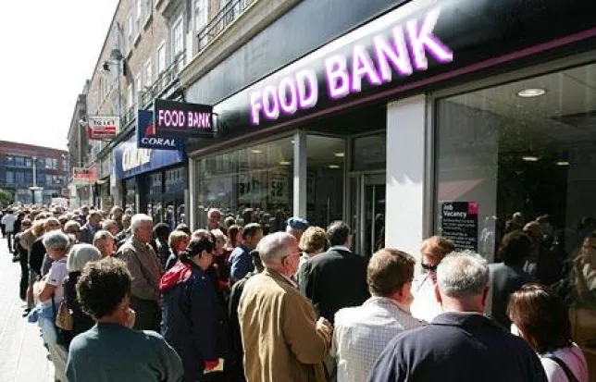
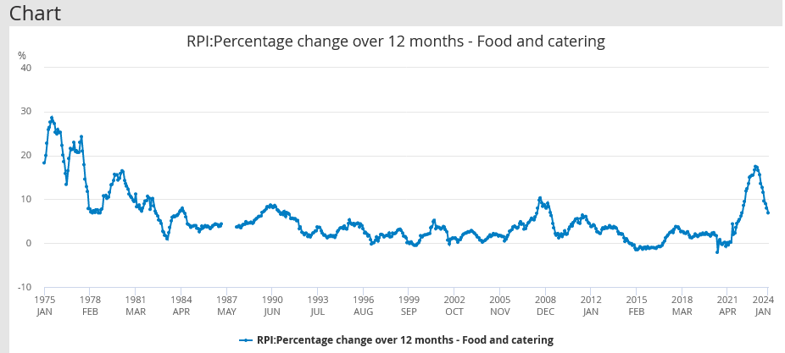
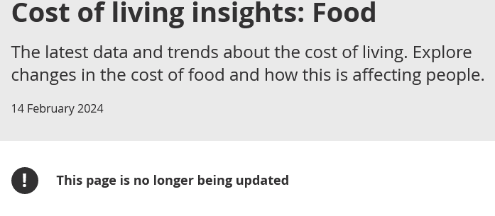
Domestic food insecurity continues:
NB no legal obligation to feed people
Battles over food costs and quality
  Food banks have become welfare
  Despite Nat’l Min Wage Act 1998 → Cost of Living crisis 2020-4
  https://www.gov.uk/national-minimum-wage
https://criticallegalthinking.com/2015/05/15/the-foodbank-dilemma-part-2-of-2/
Screenshot from ONS 19.03.24

Slide 13
Meanwhile a resilience framework evolves
1948: Civil Defence Corps created (nuclear war in mind)
2001: Civil Contingencies Secretariat (CCS) created in the Cabinet Office, responsible for emergency planning and to prepare the UK for resilience after disruption
2004: Civil Contingencies Act creates Local resilience Forums – now 38 England. 4 Wales, Scotland and N Ireland have their own Resilience Partnerships system
2007: Centre for the Protection of Critical National Infrastructure (CNI)
2008: Climate Change Act sets binding targets to reduce CO2e
2010: National Risk Register starts…. Latest in 2023
BUT LITTLE ON FOOD yet food is one of 13 Critical National Infrastructures

Slide 14
Governance level | Body | Why relevant for food resilience
Central Gov’t | Cabinet / Cabinet Office | Overall government direction
 | Department for Environment, Food & Rural Affairs | Overall food system (emphasis on agriculture/land)
 | Department of Health & Social Care | Health care
 | Foreign, Commonwealth & Development Office | External relations
 | Ministry of Defence | Armed forces protection
 | Department of Levelling Up Communities & Housing | Local authority services
 | Department of Work & Pensions | Income levels
 | Home Office | Personal and border protection; migration controls
 | Department for Business and Trade | Food trade deals
Agencies | Food Standards Agency | Food quality and standards monitoring
 | Rural Payments Agency | Financial support for primary producers
 | UK Health Security Agency | Ensuring health of population
 | National Cyber Security Agency | Protection and resilience planning for cyber attack
 | Natural England | Environmental enhancement
 | Border Force | Border policy force
Devolved nations | Scottish Government | Has duties under health, social care, infrastructure
 | Wales Government | Has duties under health, social care, infrastructure
Regional / local Government | Mayors & combined authorities (eg Cornwall) | Strategic planning; many mayors now have food strategies
 | Local authorities | Responsible for aspects of environment, trading standards, welfare services, social services
Local service | Local Resilience Forums | No food role at present
 | ‘blue light’ services | Ambulance, fire, policy
 | favoured charities: food banks, Red Cross, St John’s Amb’ | Acknowledged emergency resilience services
The many government bodies & levels involved

Slide 15
3. Why resilience politics matter
Food requires more than ‘send for the blue-light brigade’
Bounce back to business-as-usual or new status?
Top-down or civil engagement?
Need to shift from Just-in-Time to Just-in-Case food logistics

Slide 16
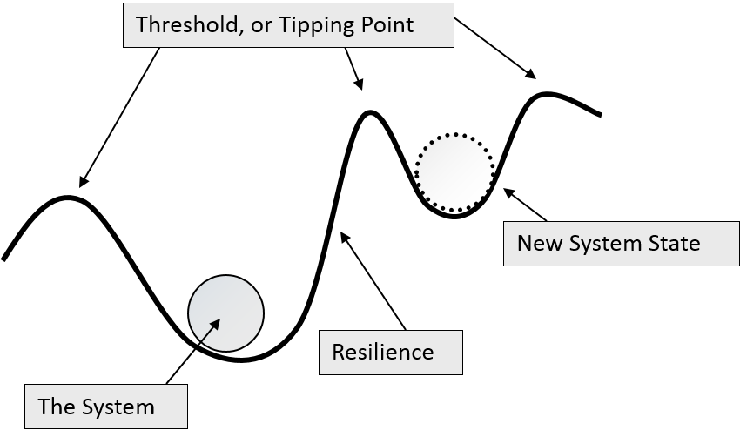
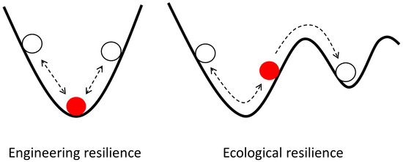
What does the term ‘resilience’ mean?
General meaning: ‘bounce back from shock’
  Perhaps to new state
Adopted by some disciplines:
  Physics: material dynamics*
  Engineering: roads, bridges, skyscrapers
  Psychology: children in adversity (war etc, Bowlby, Rutter)**
  Botany / ecology: plant life eg after fire, flood
  Public health & Disaster relief: recovery after catastrophes
Sources:
* DE Alexander (2013) Nat. Hazards Earth Syst. Sci., 13, 2707–2716 www.nat-hazards-earth-syst-sci.net/13/2707/2013/
** Fox Vernon https://link.springer.com/chapter/10.1007/978-0-306-48544-2_2
Graphic source: Philip Loring, Univ of Guelph http://www.conservationofchange.org/resilience
Graphic source: Kinchin (2022) https://www.mdpi.com/2227-7102/12/8/528

Slide 17
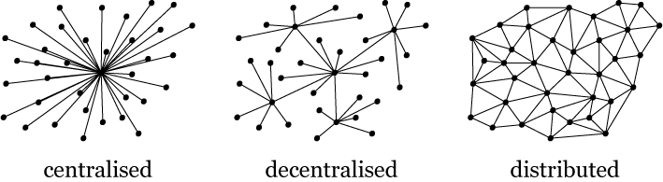
Resilience raises issues of control & centralization: which model is more resilient? (after Baran 1964, RAND Corporation)

Slide 18
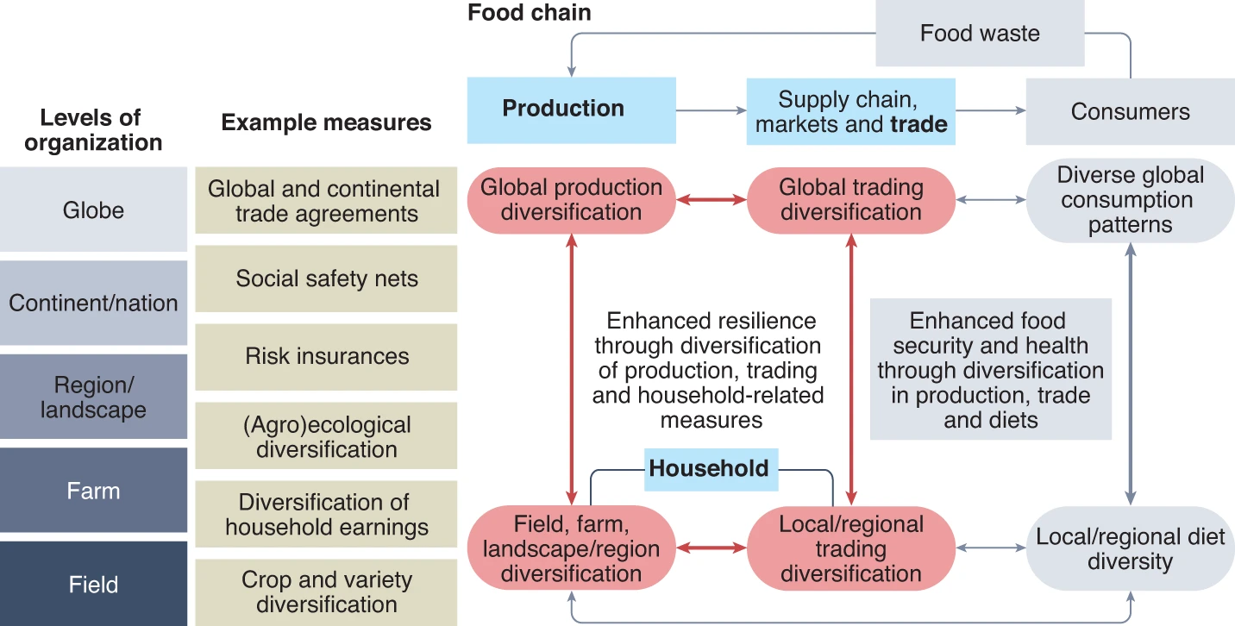
Academic case: diversification is key to resilience
Hertel et al, Nature Food, 2021: https://www.nature.com/articles/s43016-021-00403-9

Slide 19
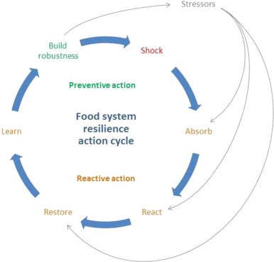
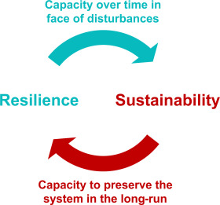
Food resilience is usually pitched as system sustainability
source: Tendall et al (2015) https://www.sciencedirect.com/science/article/pii/S2211912415300031

Slide 20
It means thinking about processes in / after shock see papers by Ingram, Zurek et al (ECI, Oxford) eg: https://www.eci.ox.ac.uk/sites/default/files/2022-05/enhancing-London-food-systems-Feb2022.pdf
3 R’s:
Robustness: ability of food system to resist disruptions to desired outcomes
Recovery: ability of food system to return to desired outcomes after disruption
Re-orientation: ability of fd system actors to accept alternative outcomes post disruption
3 adaptation approaches (to enhance food system resilience):
adapting food system activities
adapting food system drivers
adapting world views on what is wanted from food systems

Slide 21
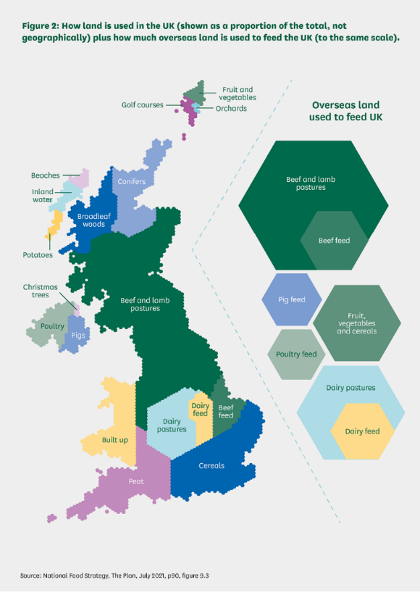
FR is often reduced to land use or self-sufficiency
(important though both are)
Origin of food consumed within the UK, 2022
source: Defra (2023) Figure 14.4
Origin of destination | Percentage of total UK food consumption
UK exports | -9%
UK | 58%
EU | 23%
Rest of Europe | 3%
Africa | 4%
Asia | 4%
Australasia | 1%
North America | 3%
South America | 4%

Slide 22
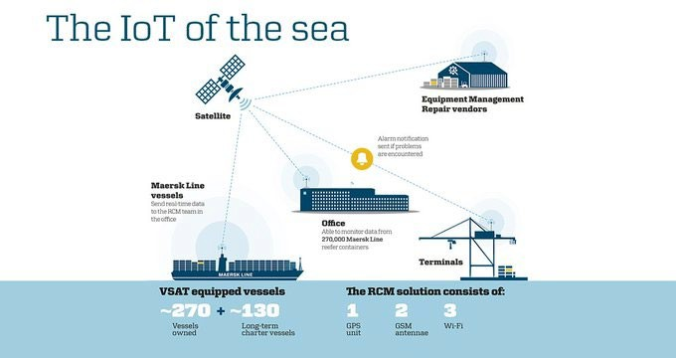
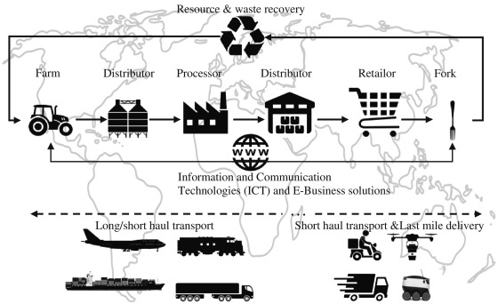
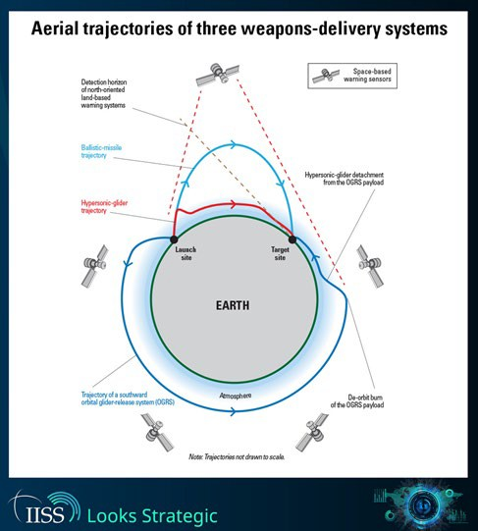
Food Commerce is vulnerable: JiT logistics - Internet of Things (IoT)
Use of satellites in modern logistics
http://maersk.com/en/the-maersk-group/about-us/publications/group-annual- magazine/2015/smart-containers-listen-and-talk / https://pic.twitter.com/Y7RB6ovqFd
Use of satellites and space in modern war & defence
Source: Gharehgazli, Iakovou, et al (2017) https://www.sciencedirect.com/science/article/pii/S2210539517300901
16

Slide 23
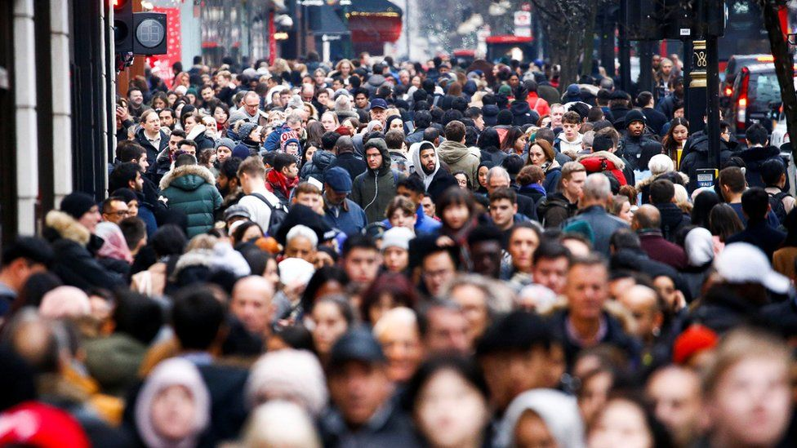
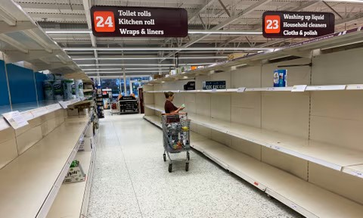
4. “it’s the public, stupid!” (after Bill Clinton)
Photo: BBC
Photo: The Guardian

Slide 24
Consumer options: individual or collective? Response and infrastructure requirements
Stockpiling: domestic or communal? What?
Household food protection: enough to eat for how long? 3-7days or 3 months?
Grow food: allotments or community gardens?
Community actions: social networks that kick in at crisis?
Food-belts: Liège (Belgium) → urban or peri-urban horticulture?
Land access: stronger demand on or controls on land use?
Rationing: by markets or by nutritional need?
Warning systems: equivalent of air raids/fire wardens? A ‘civil food defence’?
Capacity and skills: what skills would make a difference today? (raw food without cooking?)
Social change: would tackling obesity and/or diet inequalities build civil food resilience? (almost certainly yes…)

Slide 25
a new typology of Civil Food Vulnerability acute ←→chronic
Characteristic | Range of civil manifestation
Intensity | Acute: ‘severe and sudden’ shock eg rapid spread of a disease; power outage | Chronic: ‘long developed’ e.g. a population that has been unhealthy for a long time
Scale | Macro: a whole city or region is affected | Micro: a household or one food product is affected
Duration | Long-term: unhealthy population; food blockade | Short-term: a rapid invasion
Exposure | Environmental: e.g. major water pollution incident means dramatic water shortage | Socio-political: e.g. food price inflation creates some food unaffordability
Sensitivity | Quick physiological effect e.g. poisoning | Slow physiological effect
Capacity | Material resources dependency | Social resources dependency
Impact | Immediate: the food itself becomes the weapon | The impact is on infrastructure that ultimately affects food
Social determinant | Poor quality food / diet consumed by people on low incomes can mean higher vulnerability | High income or more robust housing reduces vulnerability and thus enhances resilience
Expectation and preparedness | High degree of anticipation, thus some room for preparation for shock response | Low anticipation thus potentially high shock
Maldistribution | Food exists but isn’t readily available | ‘normal’ socio-economic inequality determines access
Resource waste | Food is wasted before the public gets it | Food is wasted at or after the point of consumption

Slide 26
5. Learning from others
Laws matter (UK policy is too subject to political whim)
Focus on feeding people
Engage with people, don’t patronise them

Slide 27
Vignettes from other countries
Canada: drafting a comprehensive plan for food system resilience; critical infrastructure management; national food policy
France: 2014 law on Future of agriculture, food and forestry has created space for urban-rural innovation
Germany: advice for citizens and national government food reserve for emergences; drafting of national food policy which the goal of resilient food system
Latvia: total defence, state preparation with different ministries and industries; booklet/information for citizens
Lithuania: government food reserve; engagement/information for citizens preparedness
Sweden: total defence, state preparation and booklet/information for citizens; whole of society approach to resilience; multi-level governance approach
Switzerland: government stockpiling in collaboration with private sector; government can change import rules and order rationing and control food production in times of crises;
USA: Policies in place to enhance resilience of food system and enhance preparedness; local resilience policies; advice for citizens
Also Italy, Netherlands

Slide 28
6. The difference this makes
It reframes what we want from the food system
Reorients Institutional architecture
Opens up and grounds who gets involved
Balance of democracy and control

Slide 29
Emerging food resilience governance in Wales (with proposed new Local Food Resilience Committees)
Cabinet Office
(London)
Responsible for overall resilience planning
First Minister of Wales
Chairs the Wales Resilience Forum
Future Generations Commissioner for Wales
Monitors, audits & advises public bodies to address the long-term effects of their decisions
Deputy Minister for Social Partnership
Chairs the Wales Resilience Forum
Other relevant cabinet portfolios
e.g.: Ministers for economy; rural affairs; finance & local government; climate change, social services, etc
Deputy Minister for Mental Health and Wellbeing
Responsible for NHS delivery and performance and the Food Standards Agency in Wales
13 Public Service Boards
Ministers; chief constables; police and crime commissioner; probation services & voluntary organisations are all invited to participate
Wales Resilience Forum
Wales Resilience Partnership Team
Supports the Resilience Forum through subgroups e.g. risk assessment
Food Standards Agency in Wales
3 all-Wales NHS trusts
Public Health Wales; Venlindre University NHS Trust; Welsh Ambulance Service
22 Local Authorities
7 local health boards
3 Fire and Rescue Authorities
Other food-relevant statutory bodies
e.g. National Parks, Natural Resources Wales
Proposed new Local Food Resilience Committee
(including local food partnerships & civil society)
Local 'blue light' services
(Category 1 responders: police, ambulance, fire services)
Food supply chain
Farm, processing, retail, hospitality, logistics
Civil society in Wales
e.g.: Food Sense Wales, Food Policy Alliance Cymru, Sustainable Food Places Wales, etc.
22 food partnerships
Establishing in each local authority with some funding from the Welsh Government

Slide 30

The new political framework (RSSDDR)
Whole of society commitment
Food Infrastructure
Food Security
Food Risks & threats
Food Sustainability
Analysis and science
Low impact Food Capacity
Goal: FEED ALL PEOPLE WELL
Food Resilience
Social Resilience
Food governance
Food Democracy
Food Defence
Civil food Engagement
Food skills
Prevention & protection
Planning & Preparedness

Slide 31
Conclusions
Civil food resilience offers rich terrain for food security analysis
It’s a mistake to reduce food systems resilience to supply only
Current J-i-T logistics oil current fd system and should become Just-in-Case
UK resilience framework is interesting but too vague beyond Whitehall
Other countries suggest room for action
UK policy and process offer much for food analysis; it can be worked with
Civil focus gives many opportunities to strengthen food resilience
A broader perspective on civil food resilience is bubbling up already
Community engagement is essential about for preparedness
local/regional governance needs more powers / resources
A national scheme of local Food Resilience Committees would help

Slide 32
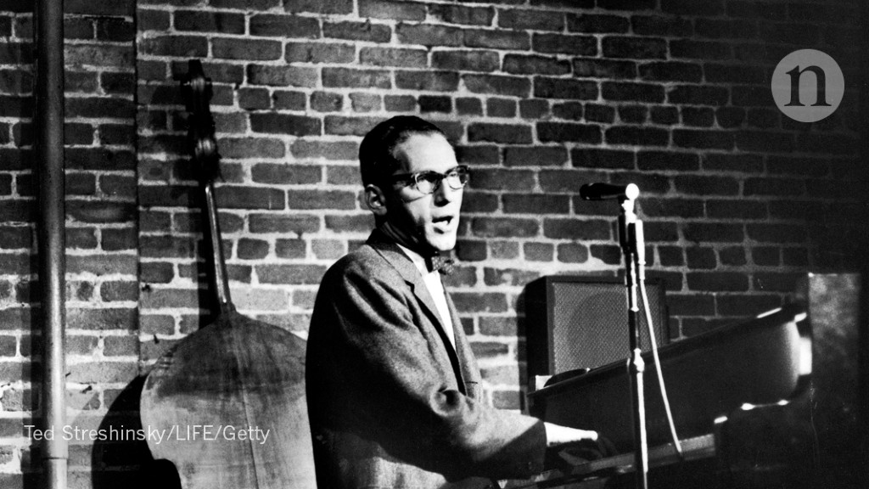
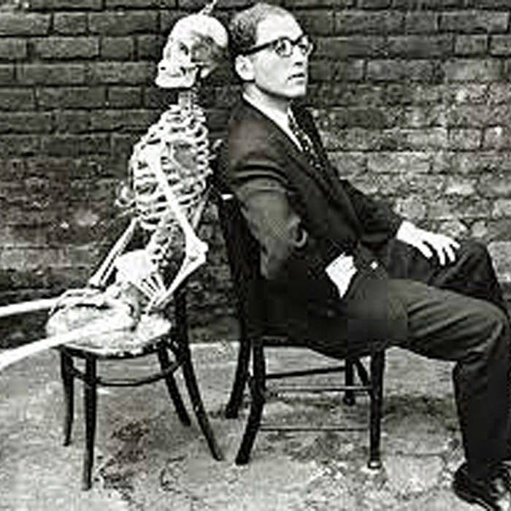
Finally, some advice from
Tom Lehrer (born 1928), mathematician & satirist
Be prepared!
That's the Boy Scouts' marching song.
Be prepared!
As through life you march along.
Be prepared to hold your liquor pretty well,
Don't write naughty words on walls if you can't spell.

